Slide 1
An Introductory Course on Modeling and Simulation
David Toth & Jeffrey Solka
University of Mary Washington

Slide 2
CPSC 109’s Development
UMW wanted to develop a computational science minor & MS
Intro course for minor, CS 1 prerequisite, gen. ed. QR
Content:
  NCSI workshop: Introduction to Computational Thinking
  Introductory programming

Slide 3
CPSC 109 in Two Sentences
“This course introduces students to the concepts of modeling and simulation as tools for solving problems in the sciences.”
“Students completing the course will be able to model complex systems and have attained programming skills equivalent to those learned in CPSC 110.”
http://cas.umw.edu/computerscience/course-offerings/

Slide 4
CPSC 109 Highlights
Motivation
Problem decomposition skills
Introduce several tools
Teach basic programming skills
Introduce agent & system models

Slide 5
Motivation – Why to M & S
Often “wet lab” experiments are not
  Nice
  Safe
  Legal
  Fast
  Cheap
  Reproducible
  Possible with current technology

Slide 6
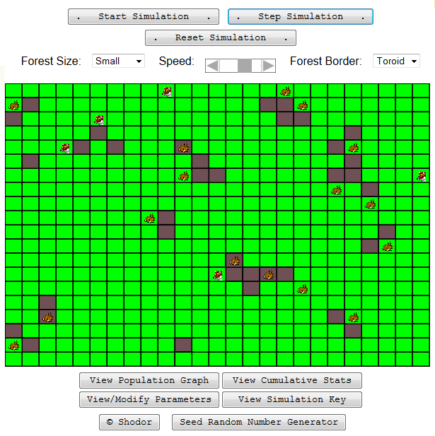
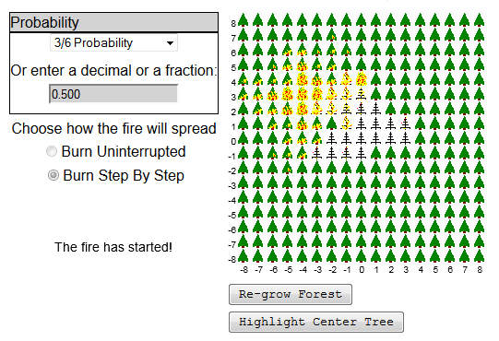
Motivation
Shodor’s Interactivate examples
And more… (drugs, galaxies, saving the delta)

Slide 7
Problem Decomposition Skills
Warmup: read & dissect articles
M & S
  Identify actors, actions, interactions
  Brainstorm factors & assess importance (zombies, fish tank ammonia, house painters problem)

Slide 8
Tools
Panther (Scratch variant)
AgentSheets
Vensim
Excel

Slide 9
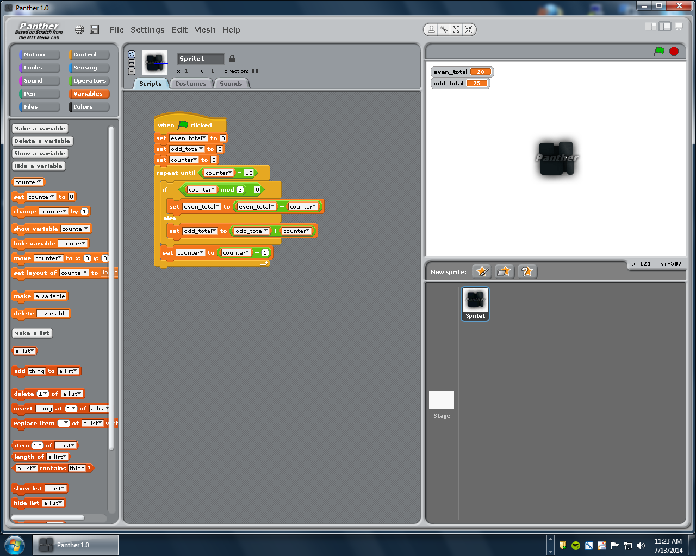
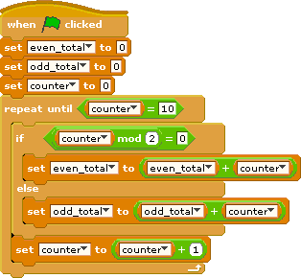
Tools: Panther

Slide 10
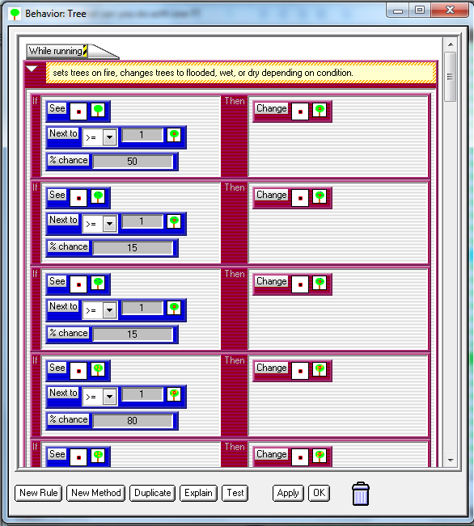
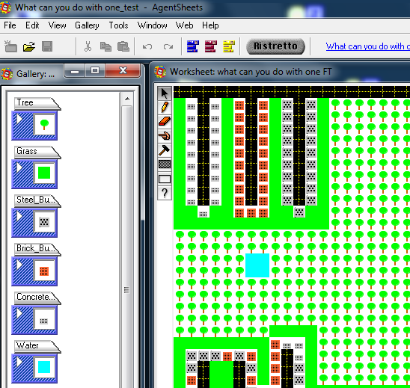
Tools: AgentSheets

Slide 11
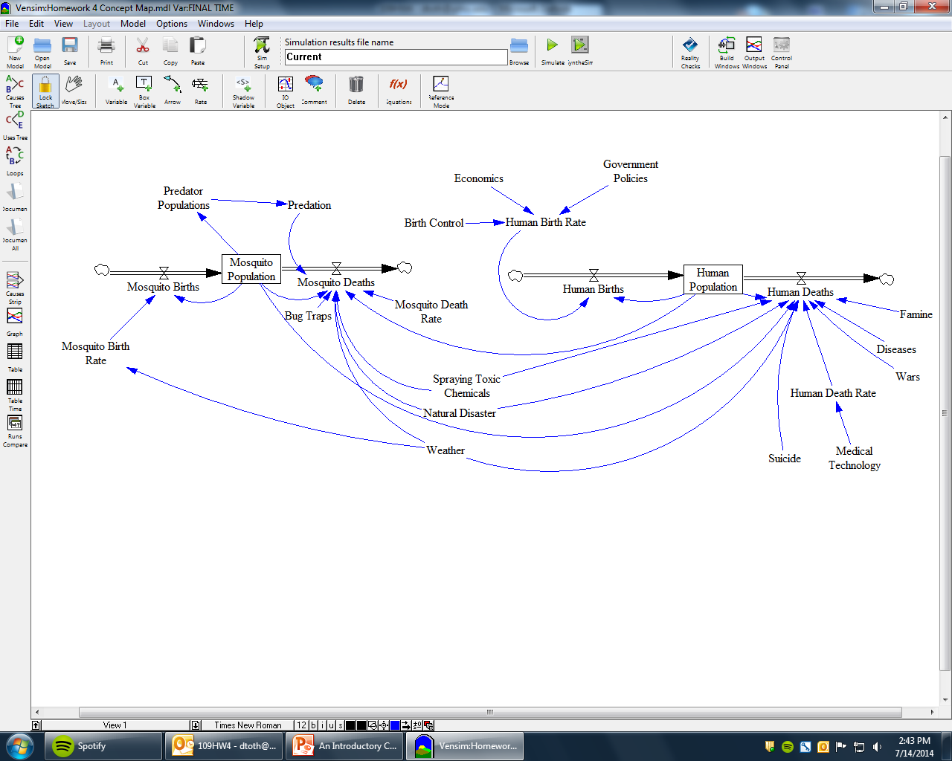
Tools: Vensim

Slide 12

Tools: Excel

Slide 13
Basic Programming Skills
Identify objective
Devise algorithm in English
Create pseudocode
Create flowchart
Translate into “code”

Slide 14
Agent Models & System Models

Slide 15
Assignments
Homework
  Drug dosage simulation, greyhound chase (Panther)
  Mosquitoes, people, & bats (AgentSheets)
  Mosquito concept map (Vensim)
Exams
  Mosquitoes (Panther)
  Conway’s Game of Life (AgentSheets)
  Monty Hall problem (Panther)
  Carbon dioxide concept map (Vensim)

Slide 16
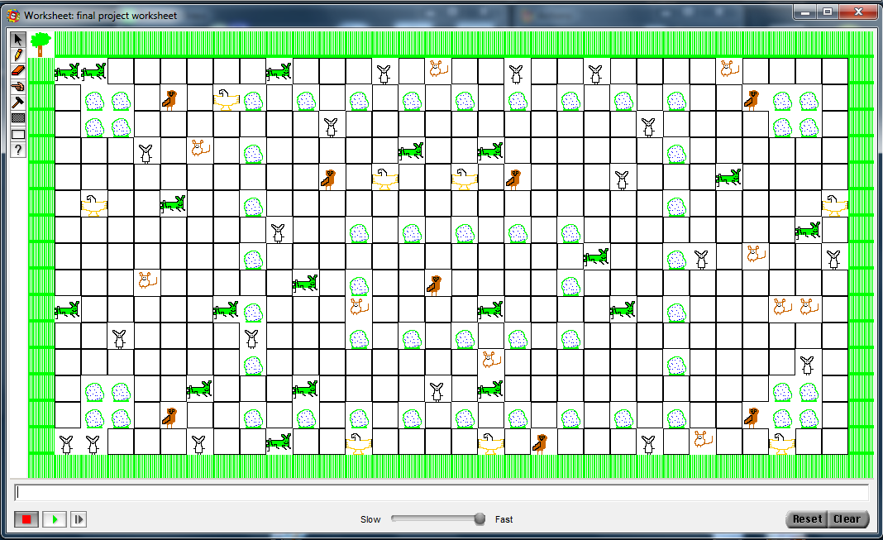
Projects

Slide 17
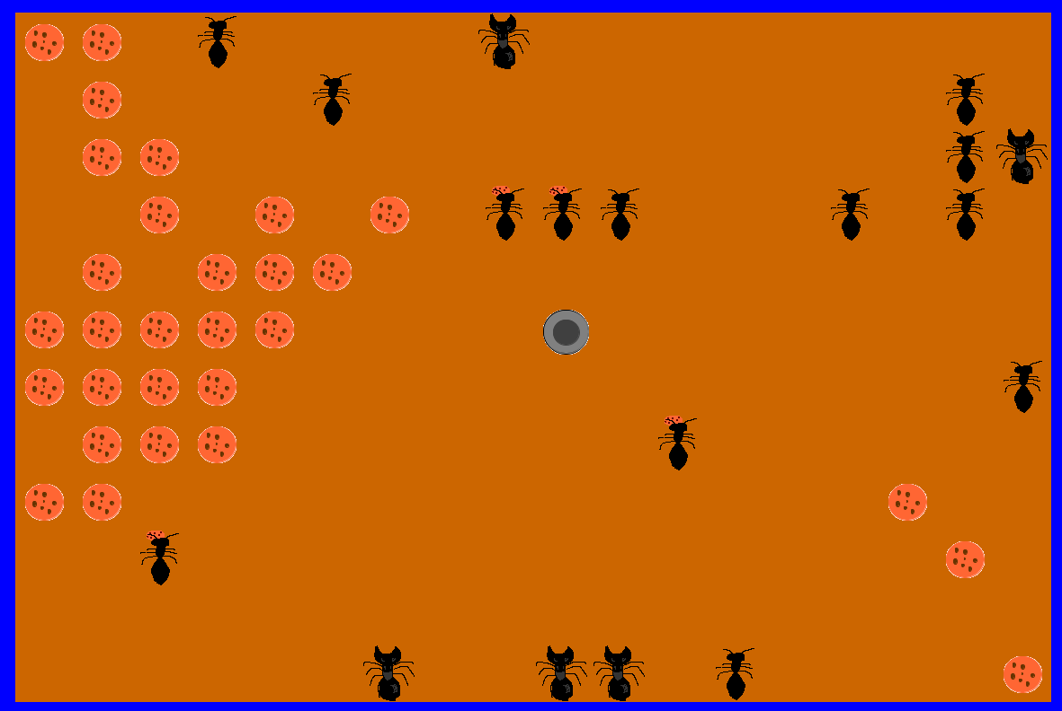
Projects

Slide 18
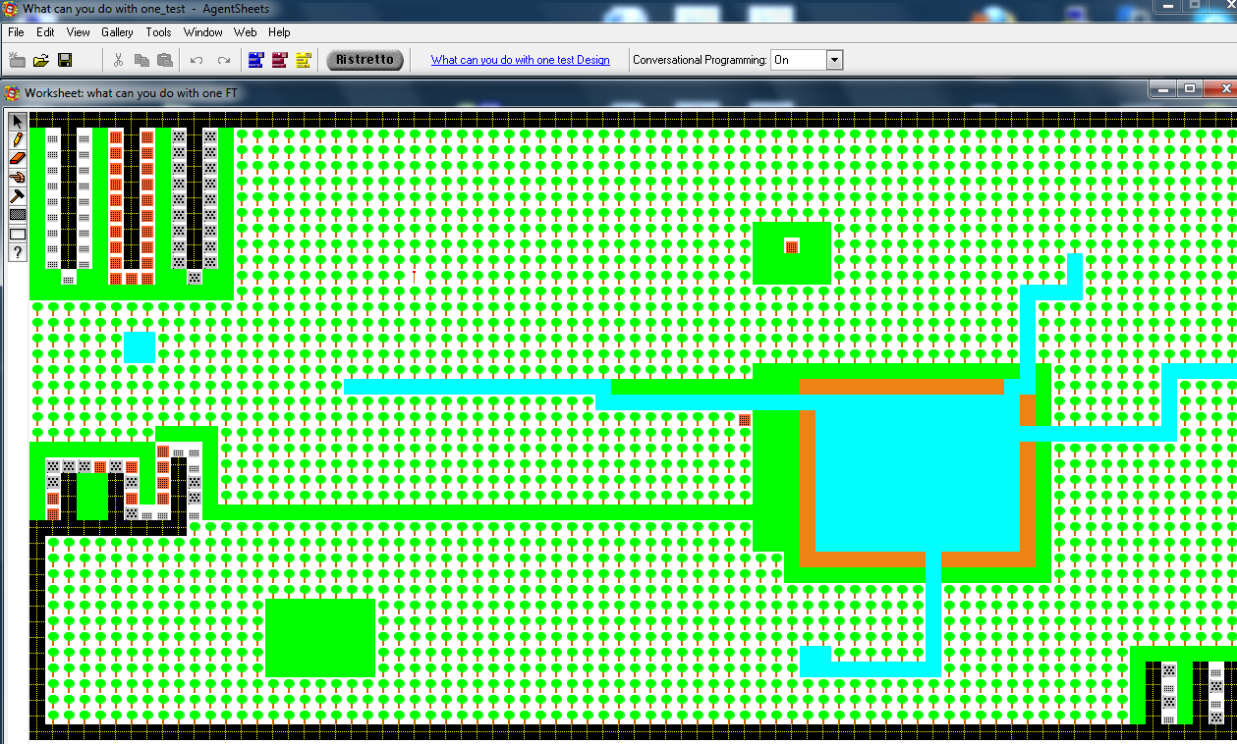
Projects

Slide 19
Projects
Disease in the trenches WWII
Colony collapse
Crops
Spread of rumors
Catching a serial killer

Slide 20
Our Experiences
Tools
  AgentSheets ☺
  Panther ☺/☹
  Vensim ☹
  Excel (*yawn*)
Videos ☺
Homeworks
Projects

Slide 21
More Experiences
Box checkers didn’t take much away (do they ever?)
Science & computer science majors took more away than others and did better
Tried to adapt to non-science audience to hold their interest (zombies, roulette)

Slide 22
Outcomes
Positive course evaluations
  “The best part of this course was being exposed to and getting to use different software packages to solve the same simulation and modeling problems. Good introductory course!”
  “I enjoyed the class very much, and it gave me a very good idea of the fundamentals of Modeling and Simulation.”
  “Best parts about CPSC109: learning about software that helps run simulations, ie. AgentSheets and Vensim. I also appreciated the exposure to Parallel Computing.”
One biology major became a Blue Waters Summer Intern doing drug discovery

Slide 23
Honors Version
Students work in teams to
  Develop examples
  Lead activities & discussions about those examples
  Replaces midterm exam at 25% of course grade

Slide 24
Follow-On Courses
CPSC 220 – Computer Science 1
CPSC 420 – Simulation Techniques: An investigation of computer simulation techniques in the modeling of various systems. Includes an examination of various types of simulations including discrete event, Monte Carlo, and continuous time.

Slide 25
David Toth
University of Mary Washington → Centre College
&
Jeffrey Solka
University of Mary Washington

Slide 26
CPSC 109 Course Description
CPSC 109 – Introduction to Modeling and Simulation: This course introduces students to the concepts of modeling and simulation as tools for solving problems in the sciences. Students will be introduced to several modeling and simulation tools and will learn how to decompose problems so they can be represented and solved with the tools. Agent models and system models will be introduced. Example problems to demonstrate the modeling and simulation techniques and tools drawn from a number of scientific fields and will introduce basic problems that will not require depth of knowledge in any particular field of science. Examples of these problems include forest fires, predatory problems, transmission of diseases, chemical reactions, and elementary particle simulations. Students completing the course will be able to model complex systems and have attained programming skills equivalent to those learned in CPSC 110. Successful completion of this course is sufficient to continue on to CPSC 220. No previous programming experience or computer background is expected.

